Slide 1
Performance and Accuracy Analysis in Object Detection
Guei-Sian Peng
California State University at San Marcos, Computer Science Department
Advisor: Dr. Nahid Majd

Slide 2

Introduction
Object detection, detecting instances of semantic objects, is a computer vision and image processing technology. A decade ago, distinction any object such as a person, animal, building, car, human face and so on, via computer was considered an unattainable task, especially like the difference between a cat and a dog even with a significant advance in the state of artificial intelligence.

Slide 3
Introduction
However, in 2012, Alex Krizhevsky et al. designed a convolutional neural network model called AlexNet, which significantly improved the performances in labeling pictures (classification) in the ImageNet challenge
Become a breakthrough in the convolution neural network, many other CNN models were springing up all over this field such as VGGNet, inceptionNet, and ResNet and so forth. Nonetheless, the convolution neural network has been studied since the 90s.
Object detection has been employed ubiquitously from the use of video surveillance, tracking object, and pedestrian recognition, just to name a few. There are multiple deep learning approaches for computer vision systems such as Region Proposals (R-CNN, Fast R-CNN, Faster R-CNN), Single Shot, MultiBox Detector (SSD), You Only Look Once (YOLO).

Slide 4
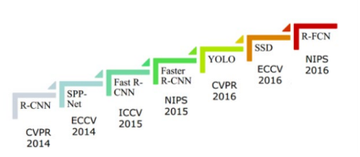
Joseph Redmon, the designer of the YOLO algorithm, claimed that the detectors nowadays are able to detect objects with a highly accurate detection rate, at a level greater than 99 percent accuracy.

Slide 5
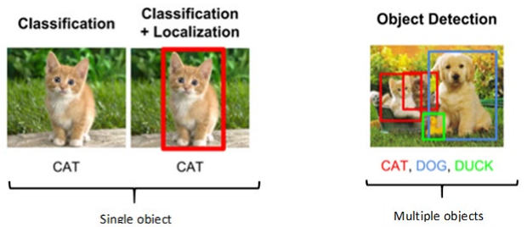
Difference between classification and object detection
Classification is to predict the labels of objects in images while detection involves not only classification but also the localization of those objects in an image.
Hence, he combination of classification and localization along with the multiple objects in an image as the image shown on the far right of figure 2 contains multiple objects – cat, dog, and duck presented in different locations with different scales and sizes.

Slide 6
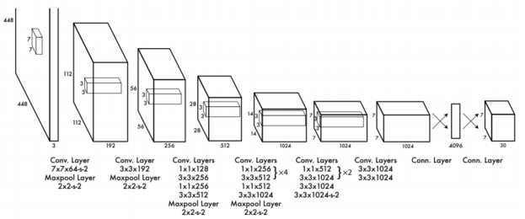
DETECTOR ALGORITHM
YOLO

Slide 7
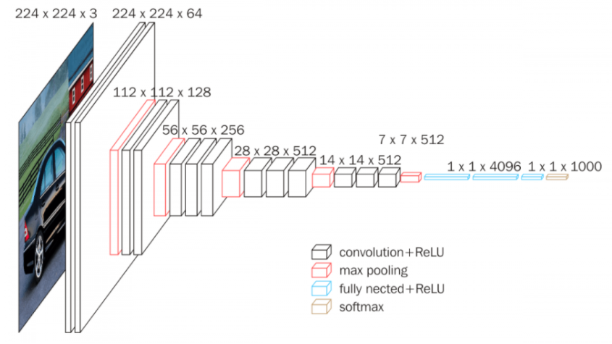
DETECTOR ALGORITHM
VGG-16

Slide 8
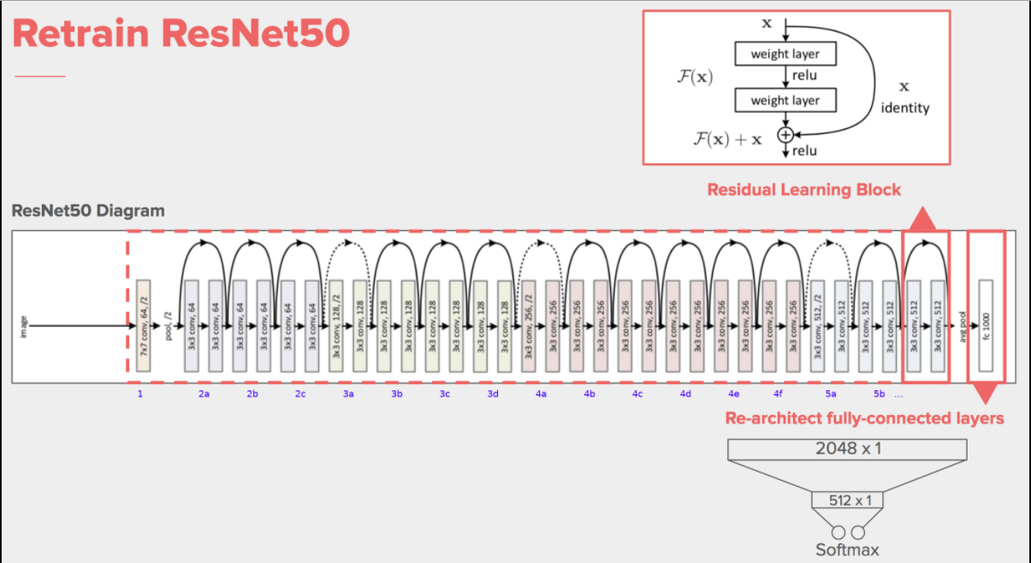
DETECTOR ALGORITHM
RESNET50

Slide 9
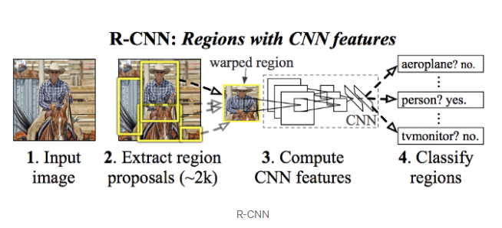
DETECTOR ALGORITHM
R-CNN

Slide 10
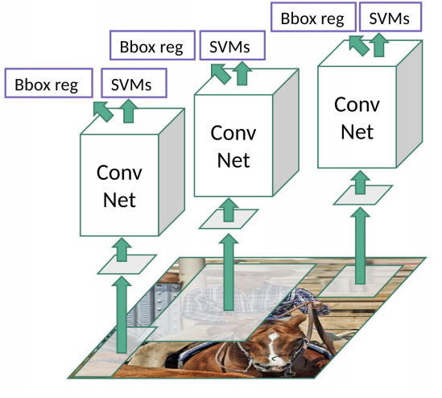
DETECTOR ALGORITHM
R-CNN

Slide 11
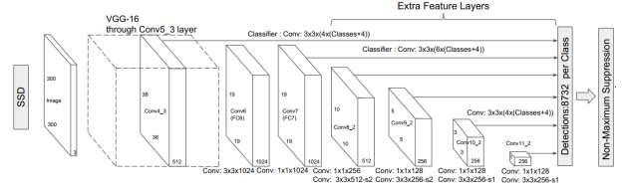
DETECTOR ALGORITHM
SSD

Slide 12
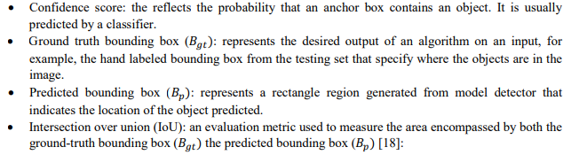

A fundamental concept of mAP for an object detector’s accuracy evaluation

Slide 13
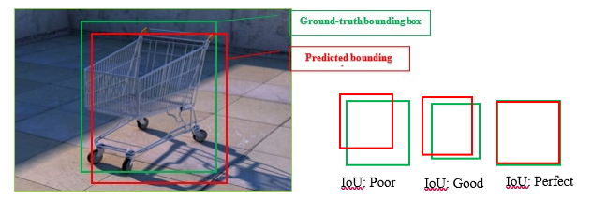

Slide 14
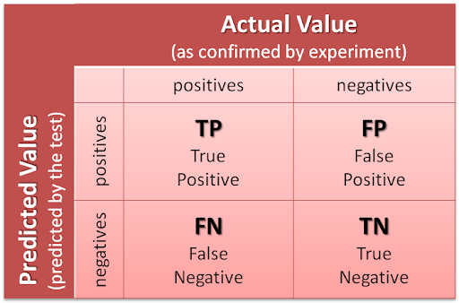
Confusion matrix
True positive (TP): Hasil Klasifikasi Positif, dimana Kelas sebenarnya juga Positif.
True Negative (TN): Hasil Klasifikasi Negatif, dimana Kelas sebenarnya juga Negatif.
False positive (FP): Hasil Klasifikasi Positif, dimana Kelas sebenarnya Negatif.
False Negative (FN): Hasil Klasifikasi Negatif, dimana Kelas sebenarnya Positif.

Slide 15
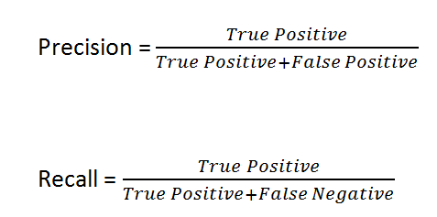
Akurasi = (TP+TN)/(TP+FP+FN+TN)

Slide 16
Pengertian
Akurasi : seberapa akurat model dapat mengklasifikasikan dengan benar
Precision : seberapa akurat antara data yang diminta dengan hasil prediksi dengan hasil prediksi (positif)
Recall : rasio prediksi benar positif dibandingkan dengan keseluruhan data yang benar positif

Slide 17
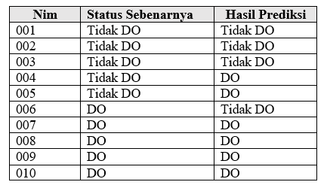
latihan
 | Aktual
Prediksi |  | DO | Tidak DO
 | DO | 4 | 2
 | Tidak Do | 1 | 3

